Slide 1
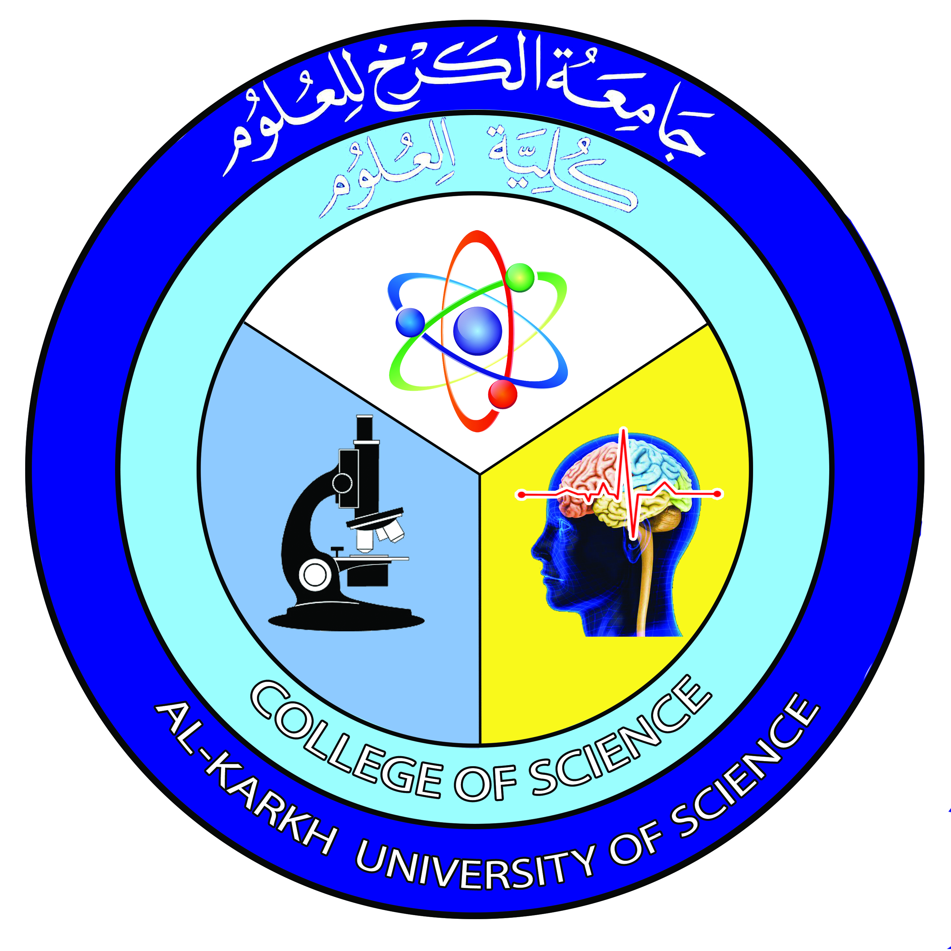
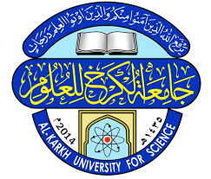
General Biology
Lecture 1
Dr. Rawa Abdul Redha Aziz
Ph.D Antibiotics/ Molecular biology

Slide 2
Subject | Lecture No.
The Science of Biology | 1
The characteristics of living organisms | 2
The Kingdom of living organisms | 3
Chemistry of life | 4
Cell structure and Function ( Animal cell ) | 5
Cell structure and Function ( Plant cell ) | 6
Mid Exam | 7
Cell life cycle ( Mitosis ) | 8
Meiosis | 9
Classification of Animal Kingdom | 10
Classification of Plant Kingdom | 11
Mycology | 12
Kingdom of Monera | 13
Viruses | 14
Final Exam | 15

Slide 3
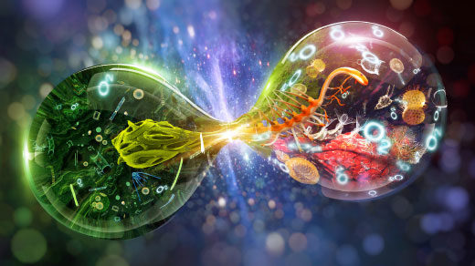
The Science of Biology
The term biology is derived from the Greek word βίος, bios, "life" and A Latin-language form of the term first appeared in 1736 when Swedish scientist Carl Linnaeus used biology in his book (Bibliotheca botanica)

Slide 4
Scholars of the medieval Islamic world who wrote on biology included Al-Dīnawarī , who wrote on botany and Rhazes who wrote on anatomy and physiology. Biology began to quickly develop and grow with Anton van Leeuwenhoek's dramatic improvement of the microscope. It was then that scholars discovered spermatozoa, bacteria and the diversity of microscopic life
Advances in microscopy also had a profound impact on biological thinking. In the early 19th century, a number of biologists pointed to the central importance of the cell. Meanwhile, taxonomy and classification became the focus of natural historians. Carl Linnaeus published a basic taxonomy for the natural world in 1735, and in the 1750s introduced scientific names for all his species

Slide 5
Serious evolutionary thinking originated with the works of Lamarck, who was the first to present a coherent theory of evolution.
In the 1940s and early 1950s, experiments pointed to DNA as the component of chromosomes that held the trait-carrying units that had become known as genes. A focus on new kinds of model organisms such as viruses and bacteria, along with the discovery of the double helical structure of DNA in 1953, marked the transition to the era of molecular genetics.
Finally, the Human Genome Project was launched in 1990 with the goal of mapping the general human genome. This project was essentially completed in 2003, with further analysis still being published.

Slide 6
Definition of Biology
Biology is the natural science that involves the study of life and living organisms, including their physical and chemical structure, function, development and evolution.
Modern biology is a vast field, composed of many branches. In general, biology recognizes the cell as the basic unit of life, genes as the basic unit of heredity, and evolution as the engine that propels the creation of new species. It is also understood that all organisms survive by consuming and transforming energy and by regulating their internal environment.

Slide 7
Why study Biology is importance?
Because of its grate variety, biology is one of the most interesting subjects and important for everyone, many biologists are working on problems that critically affect our lives, such as the world’s rapidly expanding population and diseases like CANCER and AIDS.
The knowledge that biologists are gaining will be fundamental to our ability to manage the world’s resources in a suitable manner, to prevent or cure diseases, an understanding of how organisms function is essential for us to coexist successfully with our environment and with each other and to improve the quality of our lives.

Slide 8
Subdivision or Branches of biology
These are the main branches of biology:
Anatomy – the study of form and function, in plants, animals, and other organisms, or specifically in humans.
Histology – the study of cells and tissues, a microscopic branch of anatomy.
Astrobiology (also known as exobiology, and bio astronomy) – the study of evolution, distribution, and future of life in the universe.
Biochemistry – the study of the chemical reactions required for life to exist and function, usually a focus on the cellular level.
Biogeography – the study of the distribution of species spatially and temporally.

Slide 9
Bioinformatics – the use of information technology for the study, collection, and storage of genomic and other biological data.
Biomathematics – the quantitative or mathematical study of biological processes, with an emphasis on modeling.
Biomedical research – the study of health and disease.
Pharmacology – the study and practical application of preparation, use, and effects of drugs and synthetic medicines.
Biophysics – the study of biological processes through physics, by applying the theories and methods traditionally used in the physical sciences.
Biotechnology – the study of the manipulation of living matter, including genetic modification and synthetic biology .
Botany – the study of plants.
Cell biology – the study of the cell as a complete unit, and the molecular and chemical interactions that occur within a living cell.
Ecology – the study of the interactions of living organisms with one another and with the non-living elements of their environment

Slide 10
Epidemiology – a major component of public health research, studying factors affecting the health of populations.
Genetics – the study of genes and heredity.
Hematology – the study of blood and blood-forming organs.
Microbiology – the study of microscopic organisms (microorganisms) and their interactions with other living things
Bacteriology – the study of bacteria.
Mycology – the study of fungi
Parasitology – the study of parasites and parasitism.
Virology – the study of viruses and some other virus-like agents
Molecular biology – the study of biology and biological functions at the molecular level, some cross over with biochemistry.
Pathology – the study of diseases, and the causes, processes, nature, and development of disease.
Physiology – the study of the functioning of living organisms and the organs and parts of living organisms

Slide 11
Zoology – the study of animals, including classification, physiology, development, and behavior, including:
Ethology – the study of animal behavior.
Entomology – the study of insects.
Herpetology – the study of reptiles and amphibians.
Ichthyology – the study of fish.
Mammalogy – the study of mammals.
Ornithology – the study of birds

Slide 12
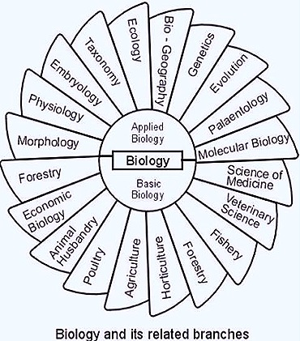

Slide 13
The characteristics of living organisms
All living things or organisms shared the following basic characteristics:
Evolution: A central organizing concept in biology is that life changes and develops through evolution, and that all life-forms known have a common origin. The theory of evolution postulates that all organisms on the Earth, both living and extinct, have descended from a common ancestor. Biologists regard the ubiquity of the genetic code as definitive evidence in favor of the theory of universal common descent for all bacteria, archaea, and eukaryotes.

Slide 14
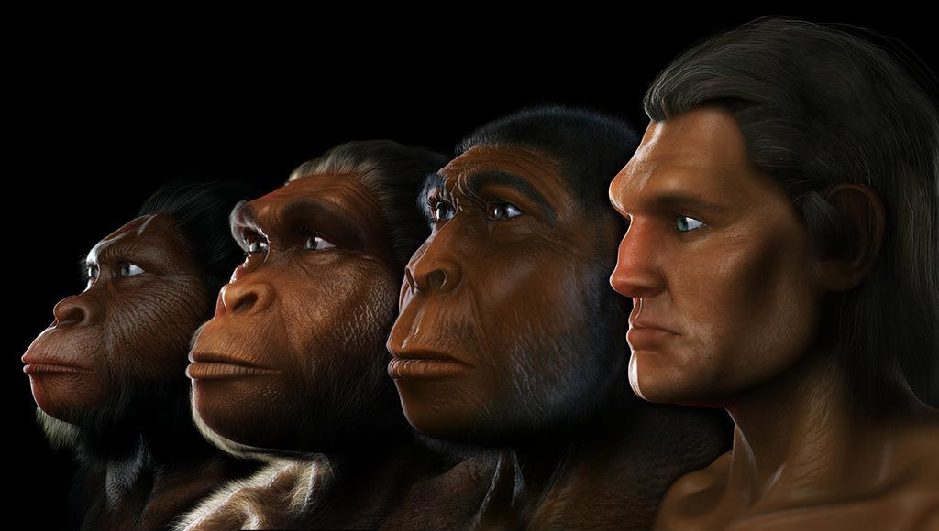

Slide 15
Adaptation: The ability to change over time in response to the environment. This ability is fundamental to the process of evolution and is determined by the organism's heredity, diet, and external factors.
Respiration: A process in living organisms involving the production of energy, typically with the intake of oxygen and the release of carbon dioxide from the oxidation of complex organic substances.
Homeostasis: Is the ability of an open system to regulate its internal environment to maintain stable conditions by means of multiple dynamic equilibrium adjustments that are controlled by interrelated regulation mechanisms. All living organisms, unicellular or multicellular, exhibit homeostasis. One example is the release of glucagon when sugar levels are too low.

Slide 16
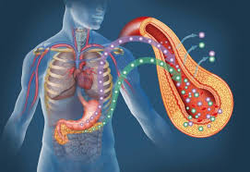

Slide 17
Organization: Being structurally composed of one or more cells – the basic units of life. Metabolism: Transformation of energy by converting chemicals and energy into cellular components (anabolism) and decomposing organic matter (catabolism). Living things require energy to maintain internal organization (homeostasis) and to produce the other phenomena associated with life.
Anabolism: The synthesis of complex molecules in living organisms from simpler ones together with the storage of energy; constructive metabolism.
Catabolism: The breakdown of complex molecules in living organisms to form simpler ones, together with the release of energy; destructive metabolism

Slide 18
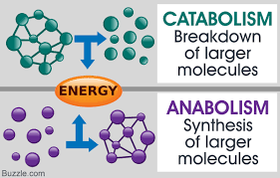

Slide 19
Growth: Maintenance of a higher rate of anabolism than catabolism. A growing organism increases in size in all of its parts, rather than simply accumulating matter.
Respond to stimuli: A response can take many forms, from the contraction of a unicellular organism to external chemicals, to complex reactions involving all the senses of multicellular organisms. A response is often expressed by motion; for example, the leaves of a plant turning toward the sun (phototropism), and chemotaxis.
Reproduction: The ability to produce new individual organisms, either asexually from a single parent organism or sexually from two parent organisms. These complex processes, called physiological functions, have underlying physical and chemical bases, as well as signaling and control mechanisms that are essential to maintaining life.

Slide 20
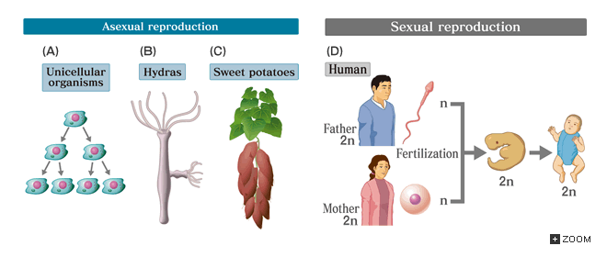

Slide 21

Any Question?

